Slide 1

MINIPROJECT: DATA ANALYSIS
SHARK ATTACKS GLOBAL REPORT
Finding safe harbor through predictive modeling and trend analysis.

Slide 2




EXECUTIVE SUMMARY
THE MISSION
LIFE & SAFETY
Analyze available global shark encounter data to identify high-risk locations and behaviors, ensuring safer tourism and aquatic sports worldwide.
By determining statistically dangerous activities, we provide the tools to prevent life-threatening experiences and enhance beach safety.

Slide 3

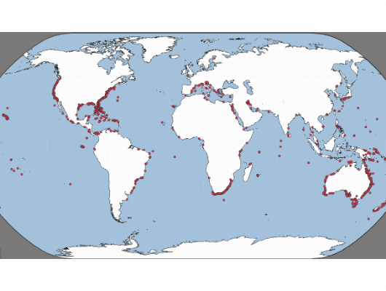
THE INFORMATION GAP
RELIABILITY VS. PERCEPTION
In a hyper-connected market, personal anecdotes often outweigh reliable data, damaging the reputation of coastal destinations.
This project bridges that gap, replacing unpredictable fear with actionable, data-driven intelligence for travelers and sports companies.

Slide 4

STRATEGIC GROWTH
Analyzing historical trends and cleaning data anomalies allows us to unlock hidden patterns that improve destination decision-making.
The Outcome: Safely introducing customers to the most secure environments for their favorite aquatic activities.

Slide 5
CORE PROBLEM STATEMENTS
Human Behavior: Quantifying the impact of human activity on encounter frequency.
Provocation: Analyzing the likelihood of provoked vs. unprovoked incidents.
Activity Risk: Identifying which water sports are most frequently impacted.
Fatality Relevance: Assessing the percentage of fatal outcomes against total sightings.

Slide 6
DATA CLEANING PIPELINE
PROFILING
IMPUTATION
CLEANING
CONVERSION
Assessment of df.info() and descriptive statistics.
Handling missing values and dropping duplicates.
Stripping strings and removing whitespace anomalies.
Casting objects to explicit datetime and numeric formats.

Slide 7






METHODOLOGY: FUNCTIONAL DESIGN
MODULARITY
AUTOMATION
STATIC ANALYSIS
Individual functions defined for every cleaning step, ensuring code reusability and clarity.
A central 'main' function orchestrates sub-functions to clean entire datasets in a single execution.
Returned dataframes fuel static visualization functions for immediate statistical insight.

Slide 8

QUESTIONS?
Transforming raw data into coastal safety.
Safe Tourism & Sports Goal

